Slide 1
Research Strategy Basics
WRTG 3020, 036
Fall 2021
Eric Klinger

Slide 2
Choose Your Subject of Inquiry
Inquiry is a process of posing questions, seeking perspectives, and building knowledge. The first step is to identify a subject or issue that matters to you. You may start with a very broad and open area of interest.
Review textbooks from your favorite classes
Scan newspapers, magazines, and documentaries
Browse online media

Slide 3
Establish your Subject Knowledge
Brainstorm key aspects of your subject: who, what, where, when, why, how. List what you already know about your subject. List what you need to know about your subject to be conversant with stakeholders.
What does [key concept related to my subject] mean?
What are the facts about [my subject]?
What are the various features of [my subject]?
What are the component parts of [my subject]?
What are the types of [my subject]?
What is the present status of [my subject]?
What are the causes of [my subject]?
What are the consequences of [my subject]?
How is [my subject] like or unlike [related concept]?
How is [my subject] made or done?
How did [my subject] happen?
When and where did [my subject] happen?
Who cares about [my subject]?
Why does [my subject] matter now?

Slide 4
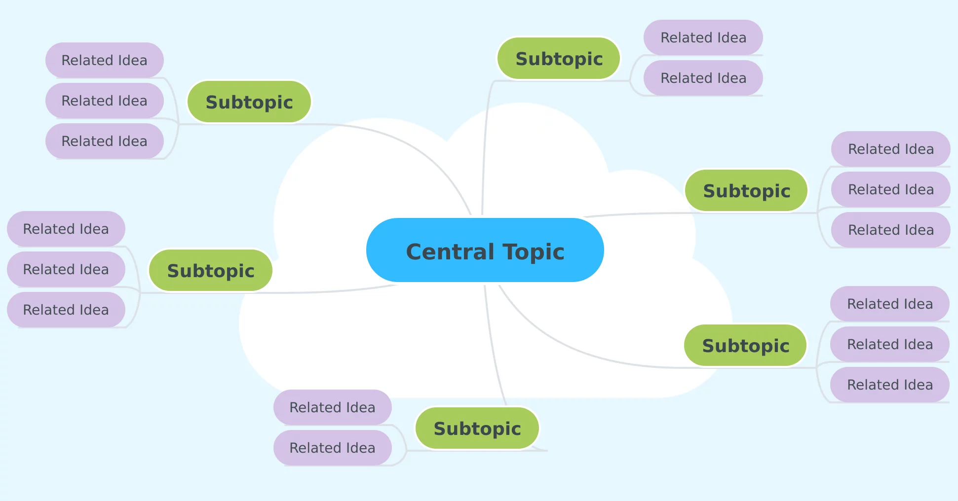
Create a Mindmap
Image: http://www.mindmeister.com

Slide 5
Develop Search Terms
State your research topic.
Example: The impact of video games on violence in teens.
Identify key concepts.
Example key concepts: video games, violence, teens

Slide 6
Develop Search Terms
Brainstorm related keywords.
Examples:
Violence = aggression, shootings, attacks
Video games = gaming, gamers, computer games
Teen = teens, teenagers, adolescents, youth

Slide 7
Develop Search Terms
Apply search strategies.
Search for synonyms.
Combine similar terms with OR.
Example: violence or aggression. Consider word variations.
Use an asterisk * to retrieve variations. Example: Teen*= teens, teen, teenagers.
Use quotations to search for phrases. Example: “video games”
Combine it all with AND
Example: “video games” AND teen* AND (aggression or violence)

Slide 8
Ask Questions that Develop Your Understanding
Consider where your questions will lead you.
Compare and contrast [How is X like or unlike Y?]
Associate your topic with another
[How did X happen in relation to Y?]
Interpret the state of your topic
[How can we measure the significance of X?]
Explore possibilities or outcomes
[How can we identify the consequences of X?]
Lead to a call for action or change
[How can we change X?]
Argue for a particular stance
[What case can be made for or against X?]

Slide 9
Conduct Background Research
Read digests or overview sources to better understand the subject, e.g., CQ researcher, Wikipedia, organizational websites, news coverage
Note key terms, key events, key people, key places
Identify sub-topics or related subjects

Slide 10
Develop More Focused Research Questions
Clarifying your question(s) to be more specific will help pinpoint what it is that you are curious about and will help you explore those curiosities.
Strong research questions:
seek complex answers
require analysis, synthesis, comparison, and critical thinking
matter to you and your audience Example:
“Is social media bad for people?” [What clarifying questions might we develop to explore this?]

Slide 11
Categorizing Sources
Information types differ in many ways, including:
Tone & Formality: casual or specialized language
Purpose: persuade, inform, sell, entertain
Form & Distribution: book, article, tweet, print, digital, fee based, free
Authorship & Editorial Process: self published, editorial review, peer review
Audience: popular, professional, scholarly

Slide 12
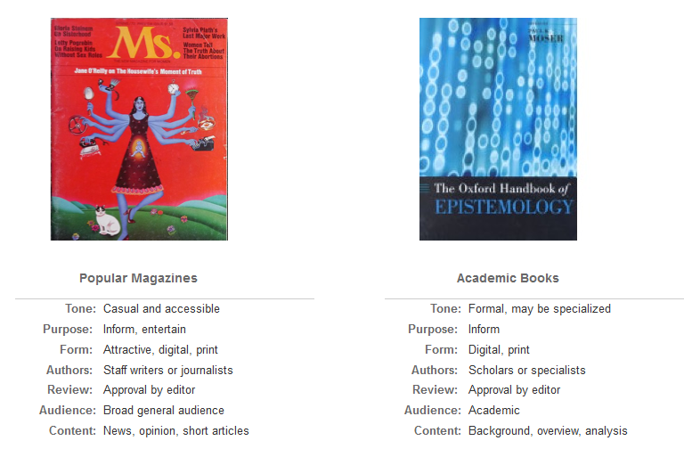
Types of Sources

Slide 13
Types of Sources

Slide 14
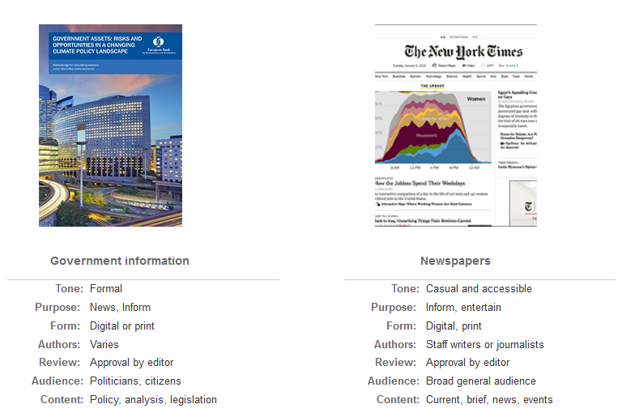
Types of Sources

Slide 15
Source Credibility
Author
Publisher
Funding source
Currency
Topic coverage
Quality
Relevance
Consensus

Slide 16
Reference
https://libguides.colorado.edu/strategies/getstarted

